Slide 1
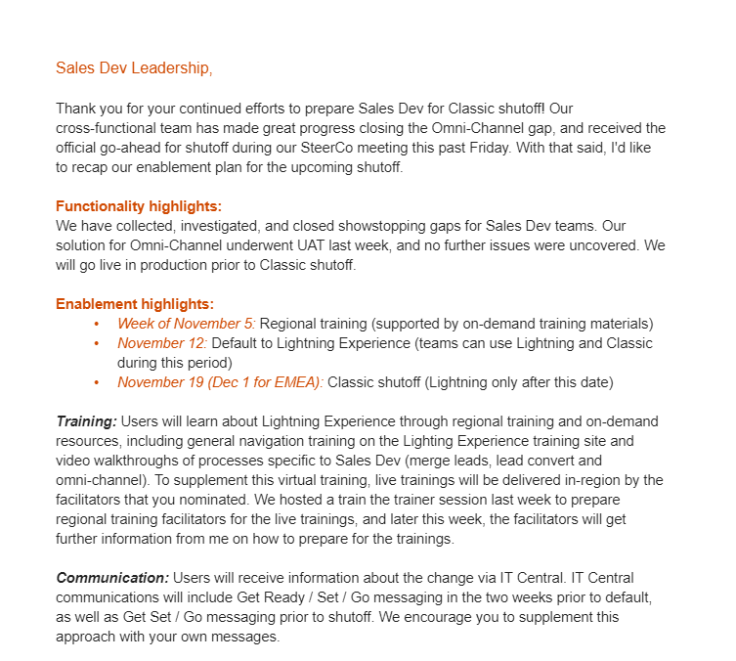
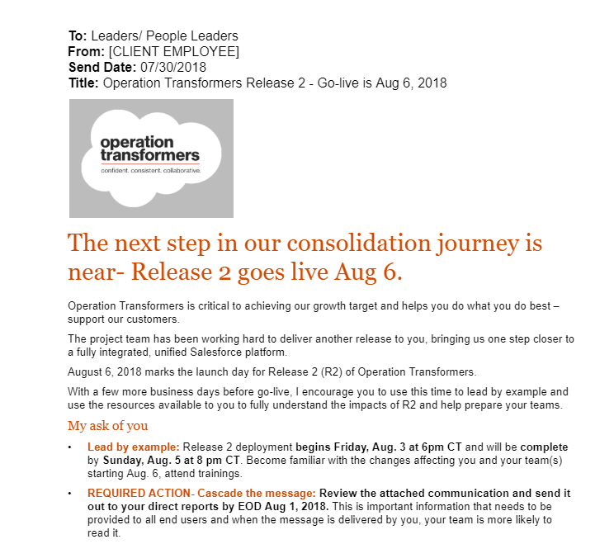
Leadership Communications: gain leadership buy-in and approval
Leadership Communications
Communications
Description:
Leadership Communications are specific messages that are sent to relevant leaders in the organization to gain buy in throughout the course of the project. In the draft of each message, the audience, send date, and sender are specified in addition to the actual communication on project details and updates.
Purpose & Value:
This deliverable adds value by creating tangible outputs that bring the communications strategy to life, and seeks to gain leadership approval. By consolidating all of the leadership communications in a single place, the change team can ensure and check for consistency across all messaging.
Material(s):
EX - Leadership Communications

Slide 2
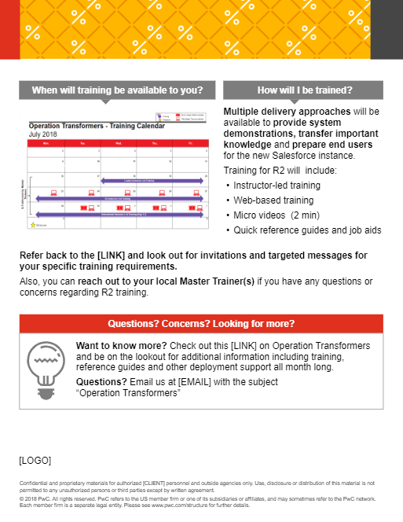
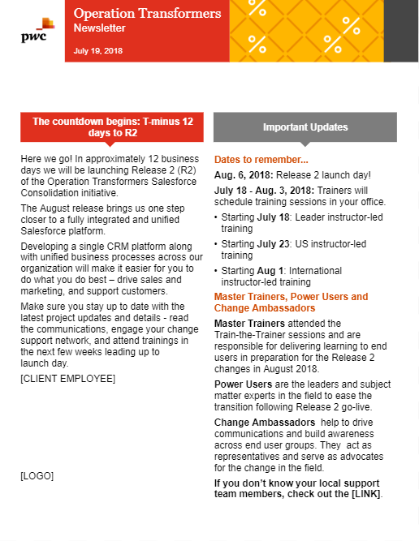
End User Communications: educate end users on the change
End User Communications
Communications
Description:
End User Communications include specific messages meant to educate end users on the change and why the organization is adopting Salesforce. In the draft of each message, the audience, send date, and sender are specified in addition to the actual communication. End User Comms usually follow a cadence, and may take the form of periodic newsletters or announcements.
Purpose & Value:
This deliverable adds value by creating tangible outputs that bring the communications strategy to life, and seeks to prepare end users for the change. By consolidating all of the end user communications in a single place, the change team can ensure and check for consistency across all messaging.
Material(s):
EX - End User Communications

Slide 3

Pulse Survey: capture stakeholder sentiment regarding the change
Pulse Survey
Communications
Description:
The Pulse Survey is a tool used to capture a quick snapshot of stakeholder sentiment before or after a change. It captures important information for analysis by job role, department and other relevant identifications.
Purpose & Value:
This deliverable adds value by allowing the change team to gather important insights into how well stakeholders understand and accept the change. The data can also be analyzed to better understand the sentiment of specific stakeholder groups and refine messaging throughout the course of the project.
Material(s):
EX - Pulse Survey

Slide 4
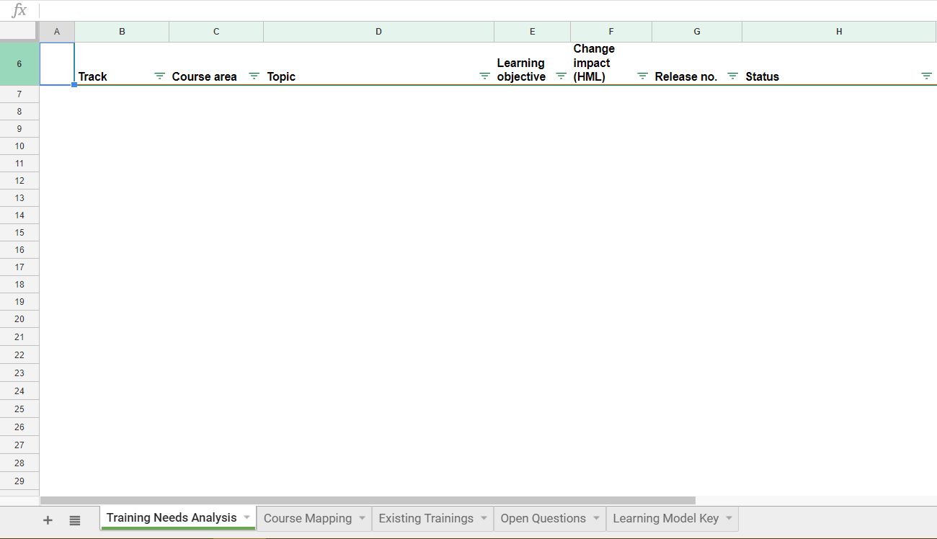
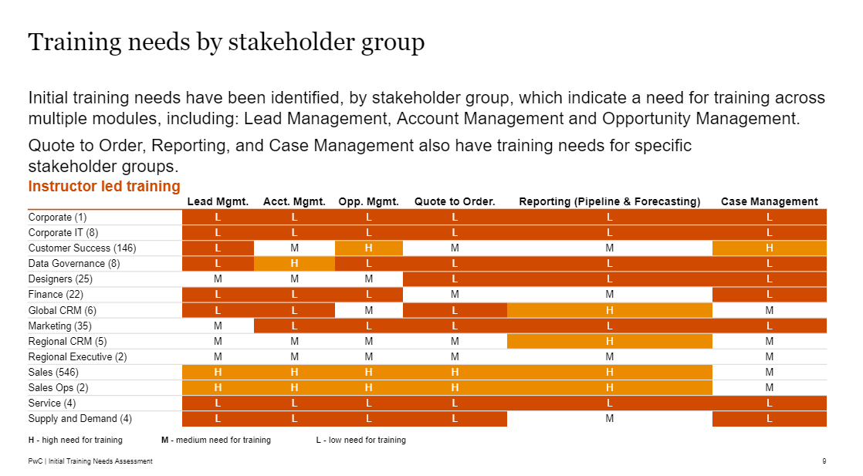
Training Needs Assessment: evaluate the required training effort
Training Needs Assessment
Training
Description:
The Training Needs Assessment identifies the specific changes that require training, the roles that are impacted, and the magnitude of the change impact. It also helps identify the required learning content by categorizing each change into a specific course area, track and topic.
Purpose & Value:
This deliverable adds value by providing the change team and client with an understanding of the training effort that will be required.
Material(s):
EX - Training Needs Assessment

Slide 5
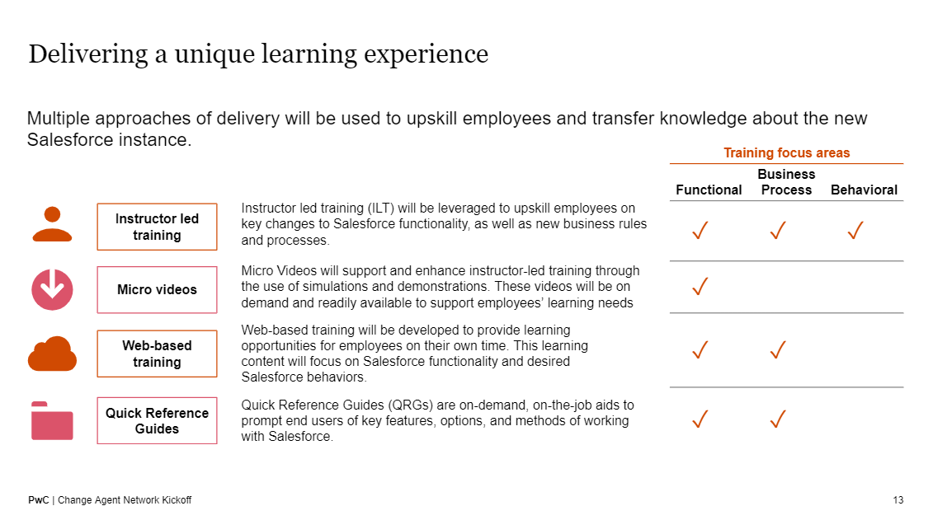
Training Strategy: craft an approach for training users on the platform
Training Strategy
Training
Description:
The Training Strategy establishes a plan for how to train specific user groups. It establishes a training approach and methodology, identifies impacted end users, and determines the training portfolio. To measure success, the strategy also includes adoption KPIs and specifies a timeline and next steps.
Purpose & Value:
This deliverable adds value by creating an overall guide for training that the project team can refer to over the course of the project. It aligns expectations and sets context for the specific materials development and logistics that follow.
Material(s):
EX - Training Strategy

Slide 6
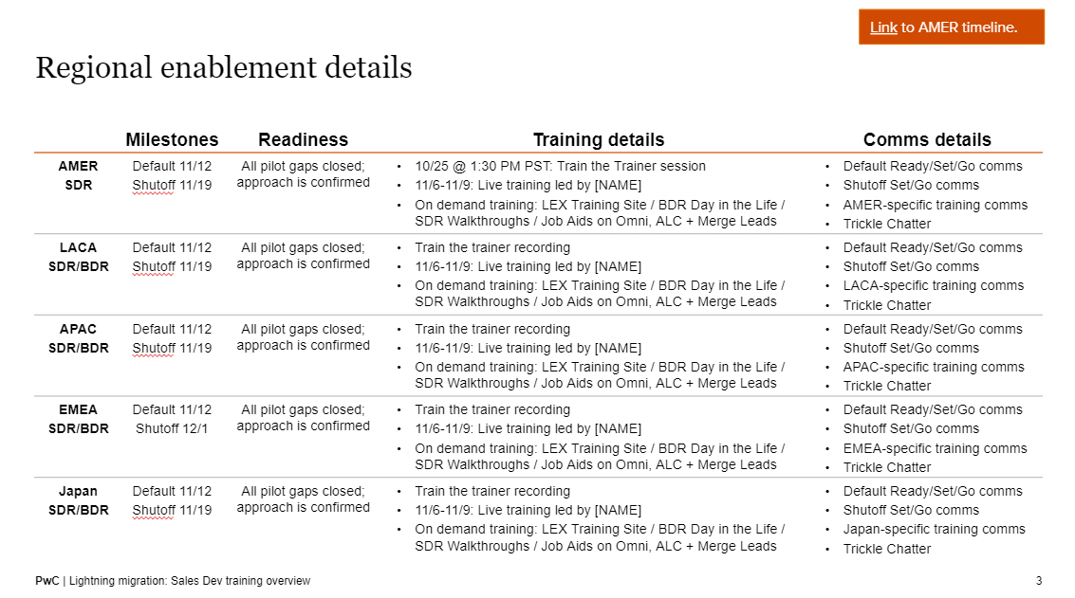
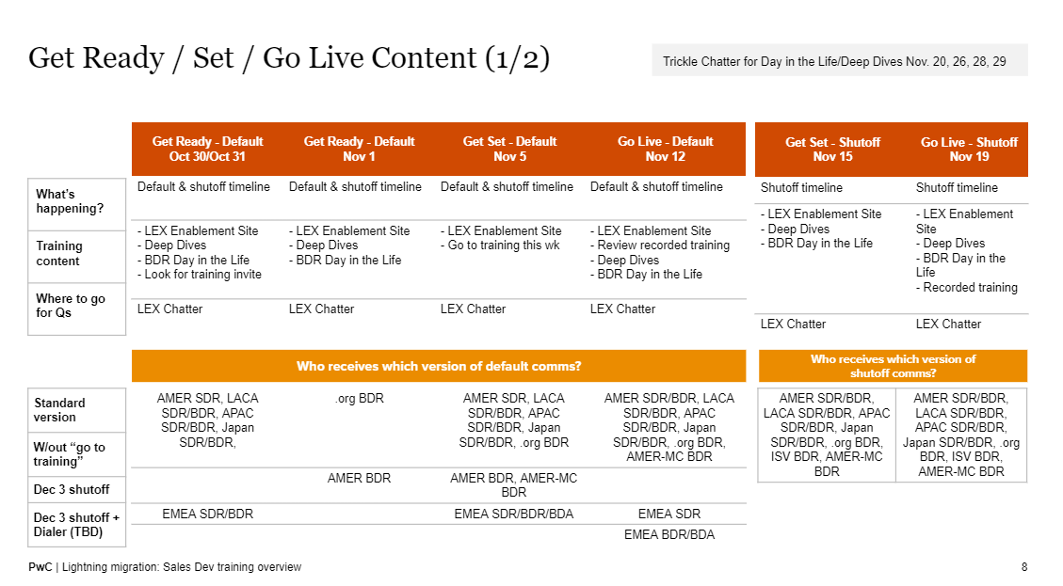
Training Plan: map out the training program with a tactical plan
Training Plan
Training
Description:
The Training Plan outlines the specific training milestones that must occur over the training lifecycle to educate end users on how to most effectively use the Salesforce platform. The plan outlines the required training materials by audience, and prescribes due dates for completion and delivery.
Purpose & Value:
This deliverable adds value by creating a tactical plan that can be utilized to track the progress of the training program and measure its success.
Material(s):
EX - Training Plan

Slide 7
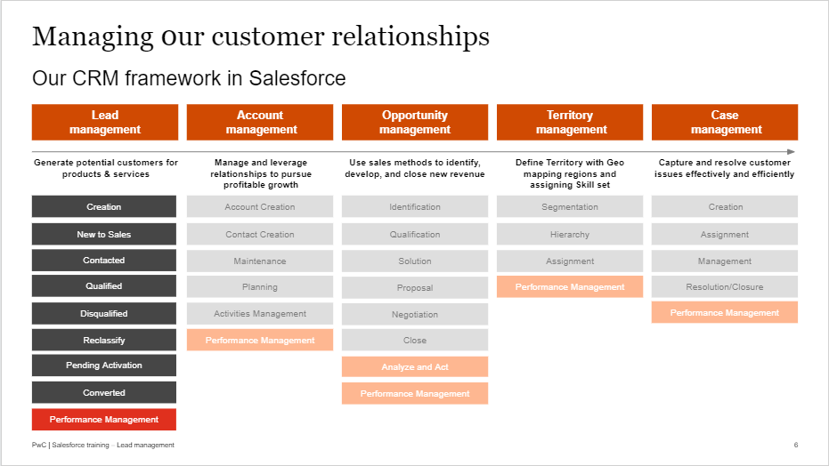
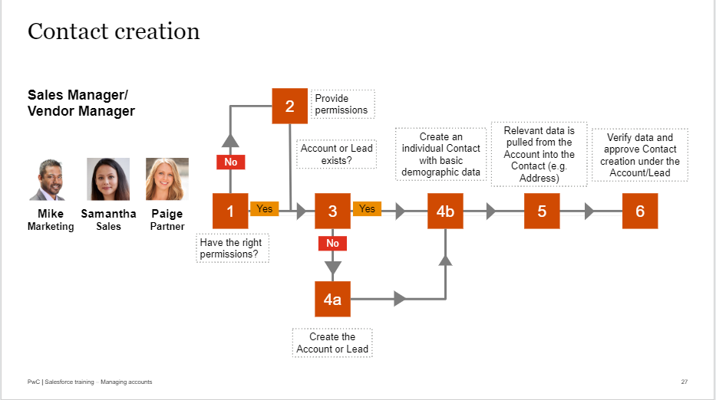
Instructor-Led Training: educate users in-person or virtually
Instructor-Led Training
Training
Description:
Instructor-Led Training is used to teach Salesforce functionality and desired behaviors to end users. This type of training is delivered live, either in-person or virtually, and is often comprised of several modules for new Salesforce users. Our ready-made user adoption journey features 5 modules (all with associated job aids): Basic Foundations, Lead Management, Account Management, Opportunity Management and Reports & Dashboards. For management level employees, there is also a module on Managing with Salesforce.
Purpose & Value:
Instructor-Led Training guides act as a tool for trainers to train end users on key changes to Salesforce functionality, as well as new business rules and processes.
Material(s):
EX - Instructor-Led Training
Check out our ready-made user adoption journey, complete with ILT modules and job aids!

Slide 8
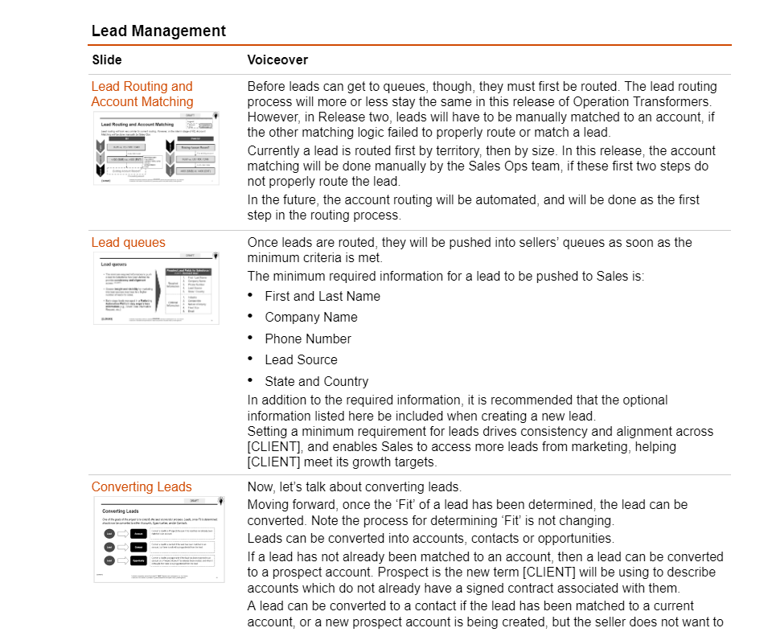
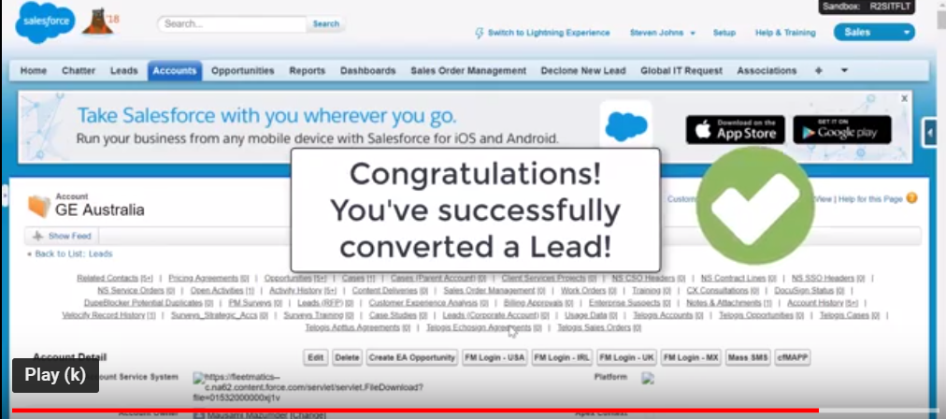
Micro-Videos: create visual demonstrations of specific actions
Micro-Videos
Training
Description:
Micro-Videos are visual demonstrations of how to execute specific actions on the new platform. They are often delivered to end users via email communications or posted on a training hub so that users can easily access and view the videos when needed.
Purpose & Value:
Micro-Videos enable learning by showing, not telling. Learners can replicate the exact actions by watching the videos. Recorded trainings allow for flexibility, as they can be accessed by end users at all times.
Material(s):
EX - Micro-Videos and Scripts
NOTE: The provided videos are for reference only. It is expected that you will work with your clients to develop customized videos accordingly.

Slide 9
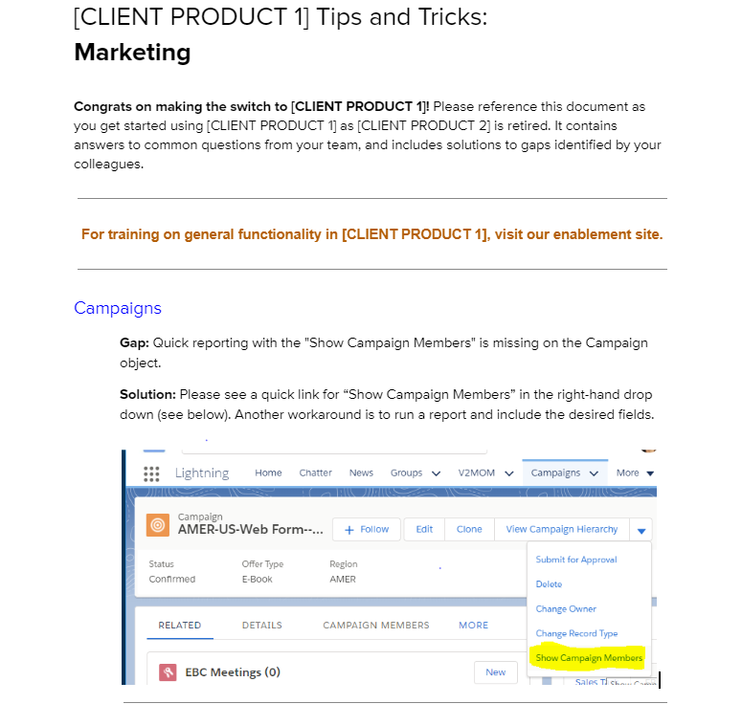
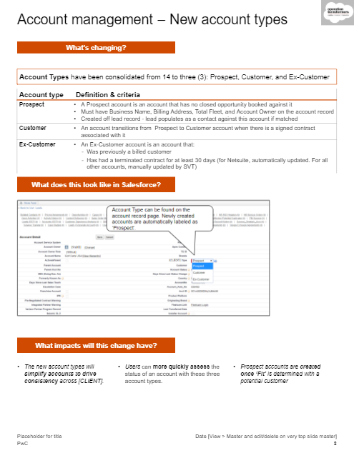
Quick Reference Guides: provide on-demand content to users
Quick Reference Guides
Training
Description:
A Quick Reference Guides is a form of on-demand training that educates end users on key features, options, and methods of working with Salesforce. Guides are often visual and provide an overview on what’s changing, what that looks like, and what the impacts of that change are.
Purpose & Value:
Quick Reference Guides act as self-service tools and provide quick, on-demand support for specific actions, enabling end users to quickly locate and receive the guidance they need.
Material(s):
EX - Quick Reference Guides

Slide 10
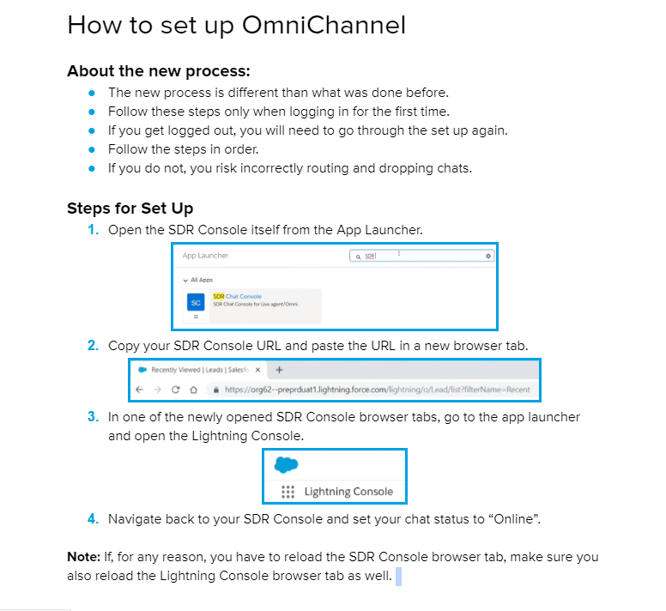
Job Aids: support on-the-job application with a reference tool
Job Aids
Training
Description:
Job Aids are repositories of relevant information that end users can refer to on-the-job to direct, guide and enhance their job-related tasks and processes.
Purpose & Value:
Jobs Aids add value by directly supporting performance in real-time for end users. Job Aids also act as a complementary resource to training, helping end users retain information.
Material(s):
EX - Job Aids

Slide 11
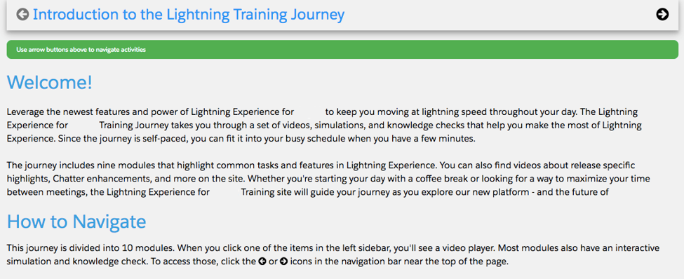
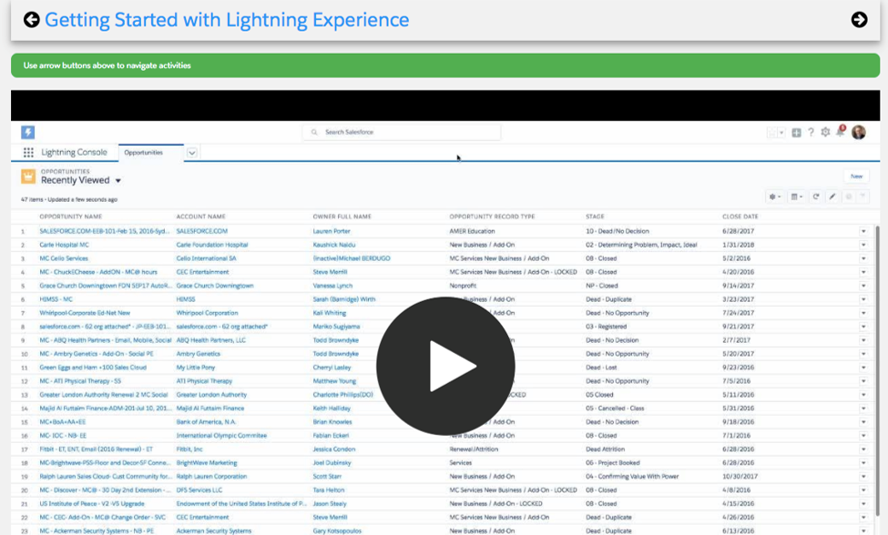
Training Hubs / Sites: aggregate training materials for quick access
Training Hubs / Sites
Training
Description:
Training Hubs and Sites aggregate key training materials and documents in one place, organized by category, process or type of asset.
Purpose & Value:
This deliverable adds value by gathering all training assets in one place for easy access and reference by end users.
Material(s):
EX - Training Hubs / Sites

Slide 12
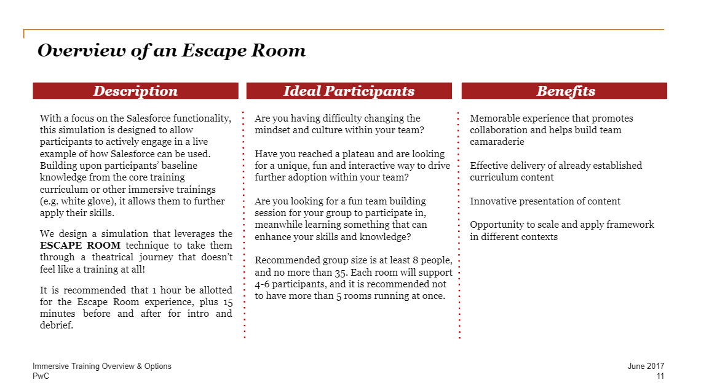
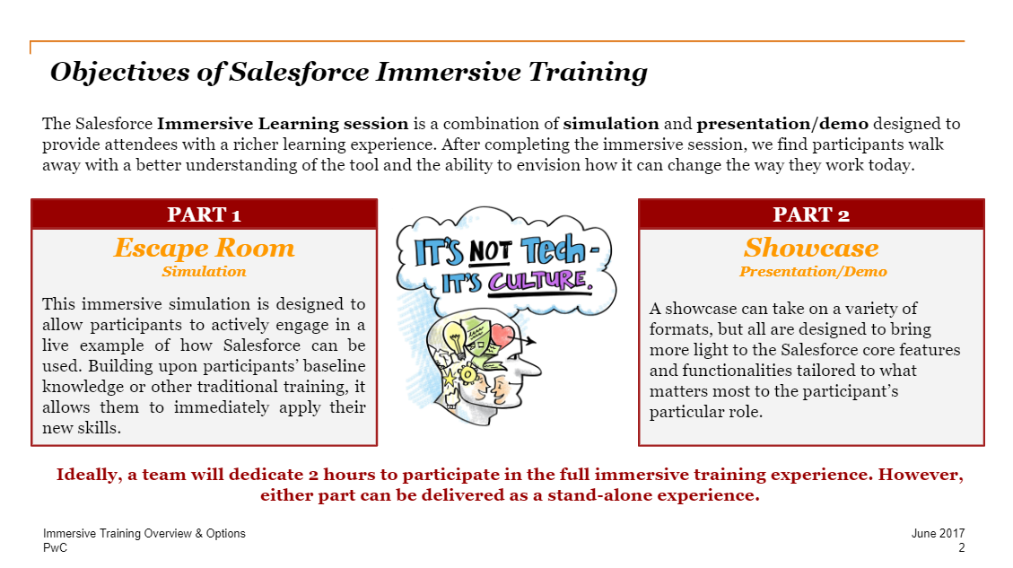
Gamification: innovate on training delivery to accelerate adoption
Gamification
Training
Description:
Gamification provides richer learning experiences for end users via immersive activities that directly highlight core Salesforce functionalities in an engaging way that doesn't feel like traditional training. Gamification is designed to be fun for the end user, and to reinforce key learning objectives.
Purpose & Value:
Gamification adds value by innovating on the delivery method of established curriculum content to create memorable and engaging experiences that accelerate end user adoption.
Material(s):
EX - Gamification

Slide 13
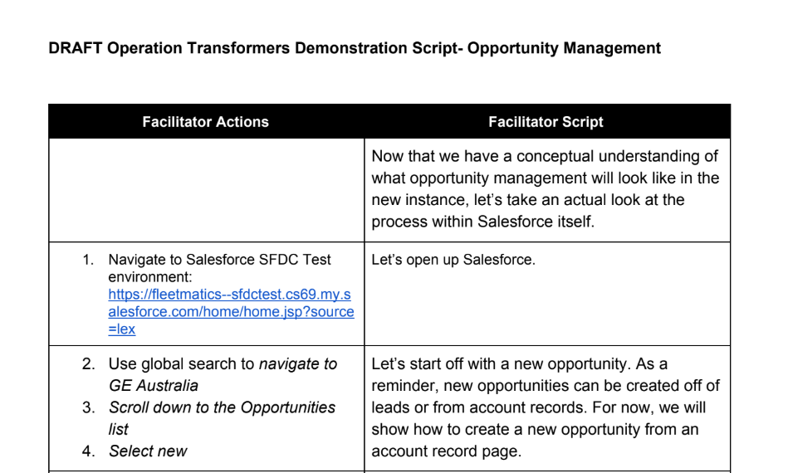
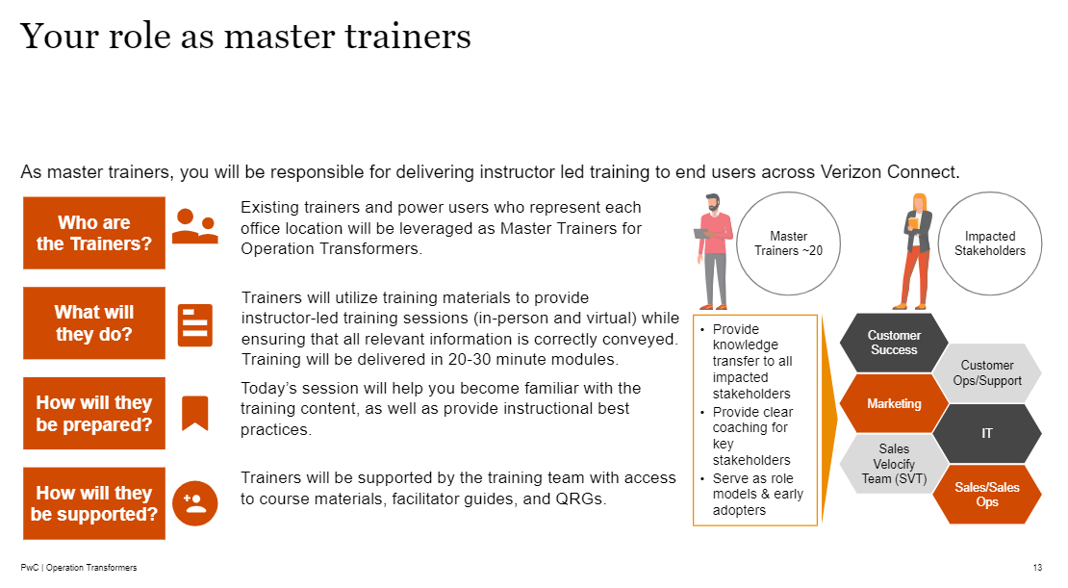
Train the Trainer: equip master trainers with the toolset to train others
Train the Trainer
Training
Description:
The Train the Trainer session prepares master trainers with the knowledge and skills necessary to deliver training sessions. The deliverable provides an overview of the transformation, then outlines the roles and responsibilities of the master trainers, key learning points, learning theory and more.
Purpose & Value:
Equipping master trainers with strategies and tools to lead workplace training will help deliver better learning outcomes and adoption across the organization. The guide also ensures consistency across trainings.
Material(s):
EX - Train the Trainer

Slide 14
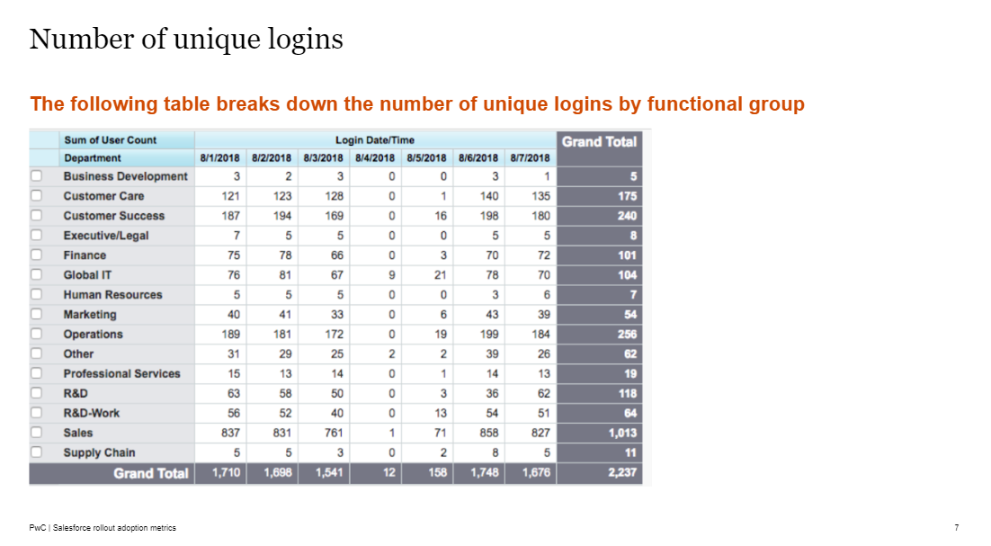
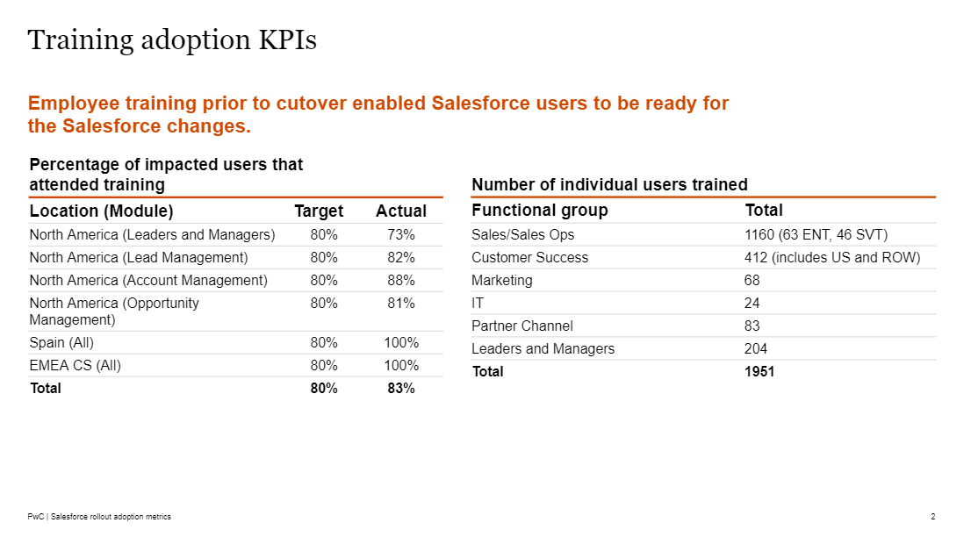
Adoption Metrics: use a variety of metrics to measure success
Adoption Metrics
Support
Description:
Adoption Metrics measure the overall adoption, user satisfaction and awareness of the change initiative. Adoption Metrics include a number of measurements, such as training attendance, system logins, registrations, and more.
Purpose & Value:
This deliverable adds value by helping the client team measure success of the change initiative in a tangible way.
Material(s):
EX - Adoption Metrics
Notes:
usage reports and surveys that explore user satisfaction and overall awareness.

Slide 15
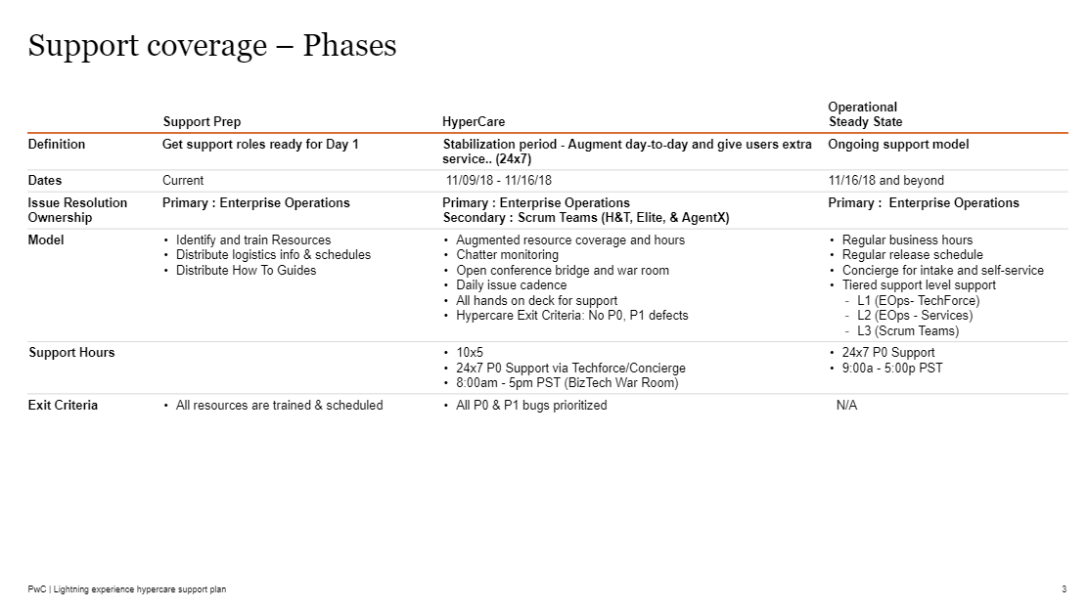
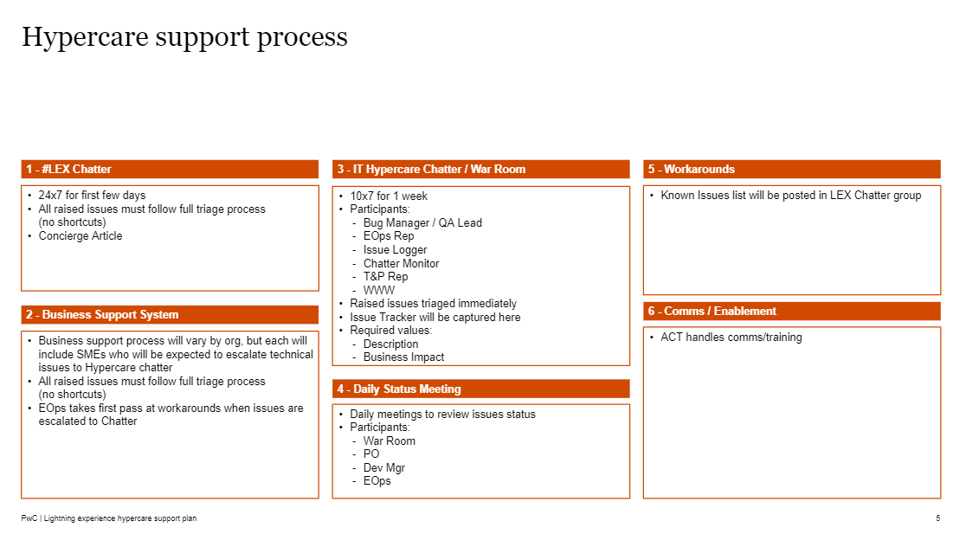
Go-Live Support Plan: define and enable key support groups
Go-Live Support Plan
Support
Description:
The Go-Live Support Plan identifies and defines the roles and responsibilities for the change team as they prepare to provide end user support during and after go live. Other details of the support plan are expanded details into the support model, such as support definitions and priority levels, governance, service level agreements, and more.
Note: usually PMO owns the creation of this deliverable, and the change workstream supports.
Purpose & Value:
This deliverable adds value by aligning support teams on the post-go live support model with key information and guidance.
Material(s):
EX - Go-Live Support Plan

Slide 16
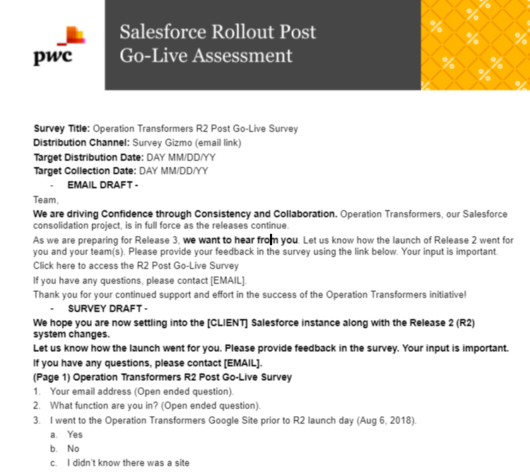
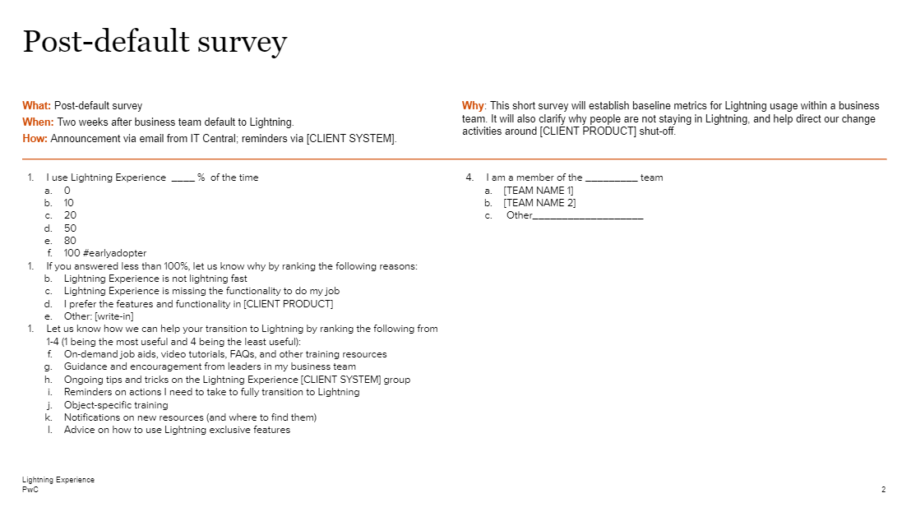
Post Go-Live Assessment: measure the effectiveness of the change initiative
Post Go-Live Assessment
Support
Description:
The Post Go-Live Assessment captures data on whether the change was effective. It considers a number of factors including behavioral changes, acceptance of change, adoption of new ways of working and KPI outcomes.
Purpose & Value:
This deliverable adds value by measuring the effectiveness of the change activities, which can assist the organization in planning future change initiatives.
Material(s):
EX - Post Go-Live Assessment

Slide 17
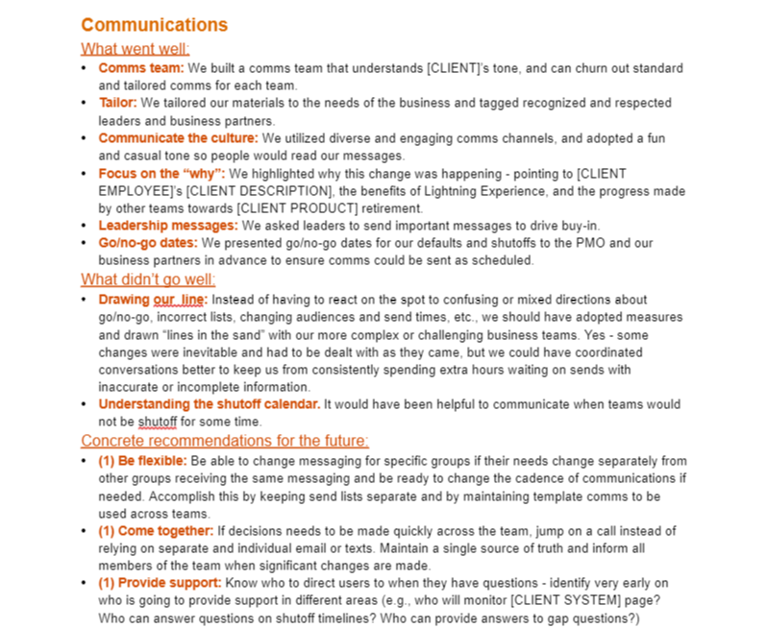
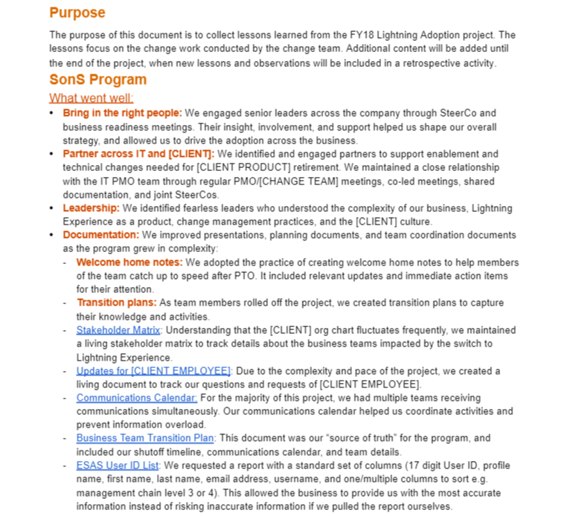
Lessons Learned: document best practices for future change efforts
Lessons Learned
Support
Description:
The Lessons Learned document collects all of the key lessons related to change work that were gathered during the project. Across readiness, communications and training, the document specifically outlines what went well, what didn’t go well, and concrete recommendations for the future.
Purpose & Value:
This deliverable adds value by gathering the reflective insights from the project all in one place for future reference and application.
Material(s):
EX - Lessons Learned

Slide 18

4 – Change Enablers
18

Slide 19
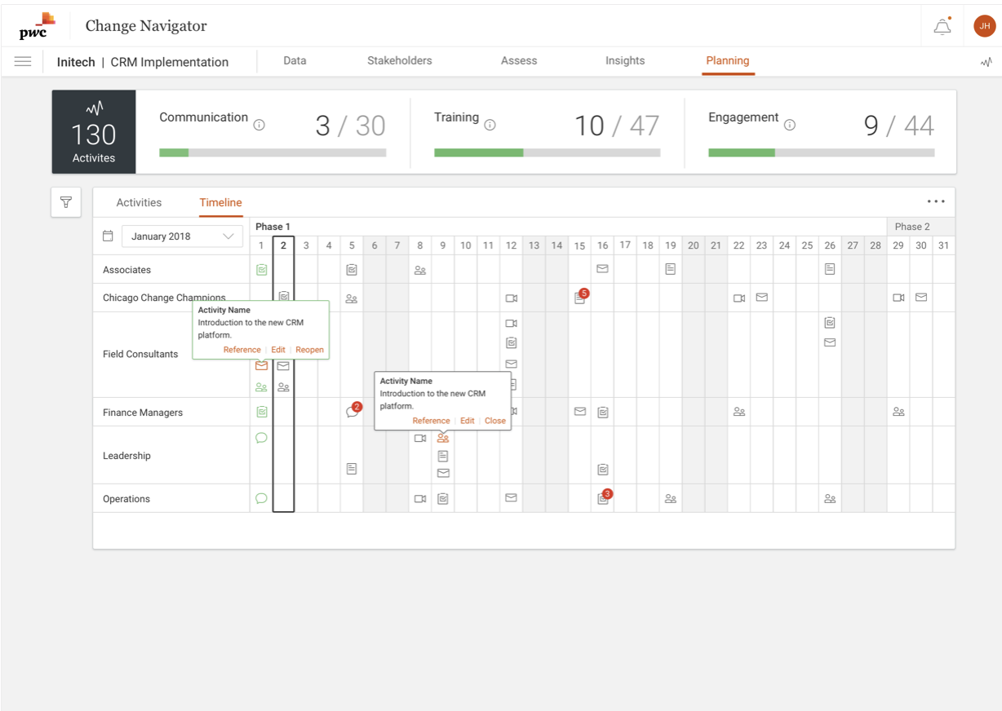
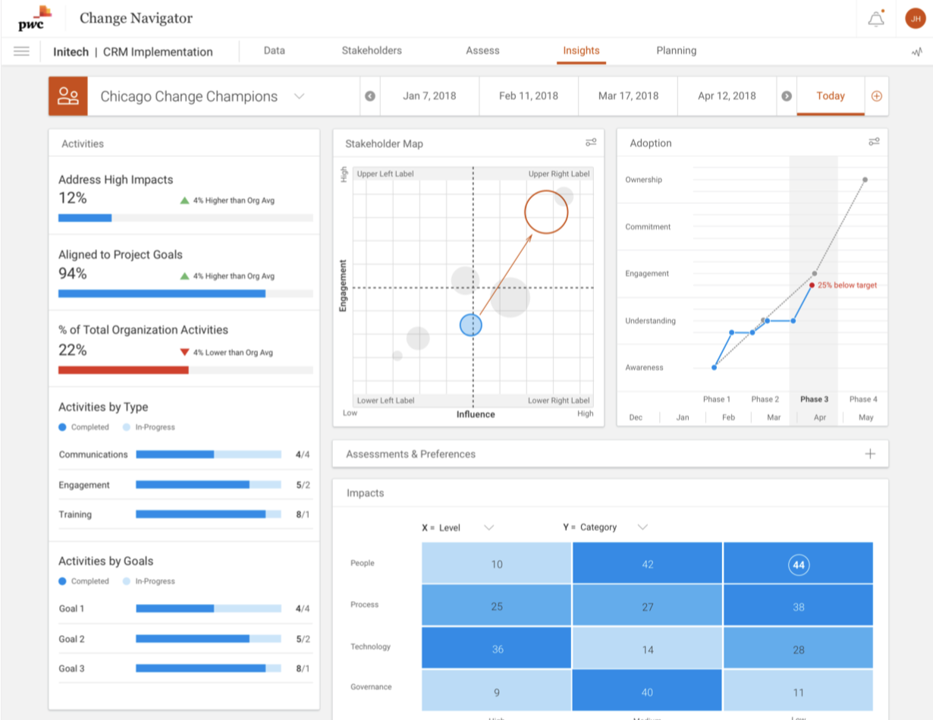
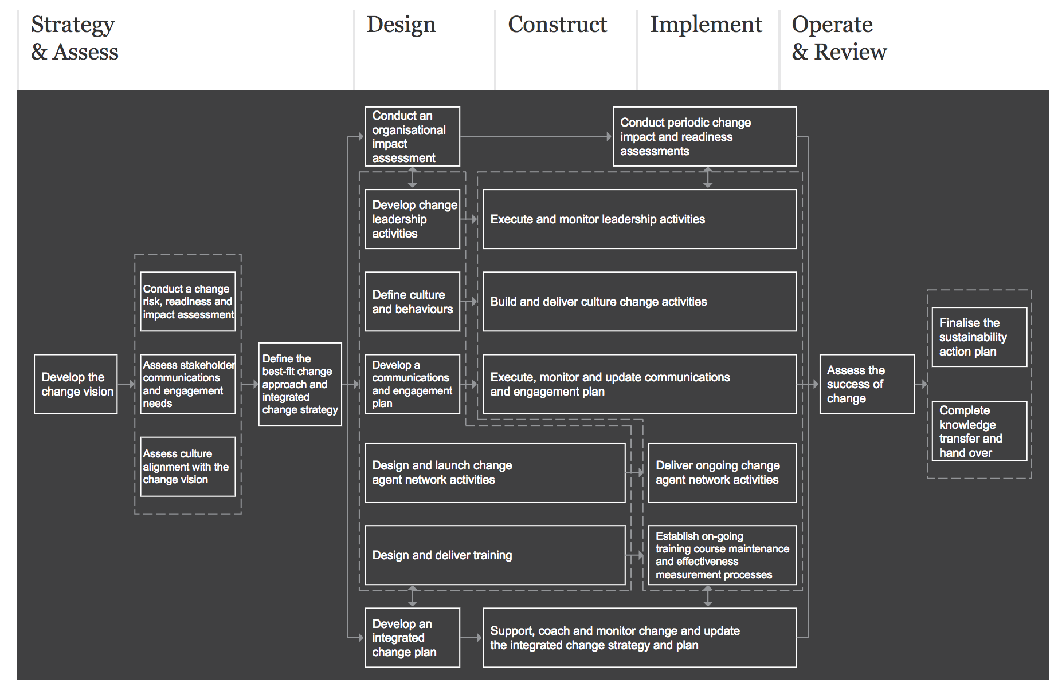
PwC’s Change Navigator is a digital change workbench
Navigator is a collaborative online workflow tool that helps PwC teams manage strategic transformations
Data-driven insights
Strategy-to-execution
Practitioners can drive more effective change with powerful data collection tools & digitized organizational assessments that produce data-driven stakeholder-level insights.
Leverage Navigator for the full OCM methodology: Assess impacted stakeholder groups, identify roll-out obstacles, create comprehensive change plans, and track the impact of change activities.
Why was Change Navigator created?
To transform PwC’s award-winning* OCM methodology into a digital workflow tool. Instead of spending hours filling out spreadsheet templates, practitioners leverage online tools to rapidly analyze a client’s change environment in order to build and execute a change plan.
Want to know more? Check out this recorded Webex!

Slide 20
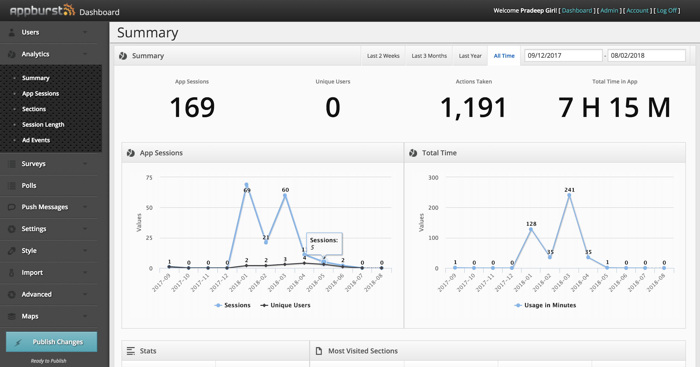

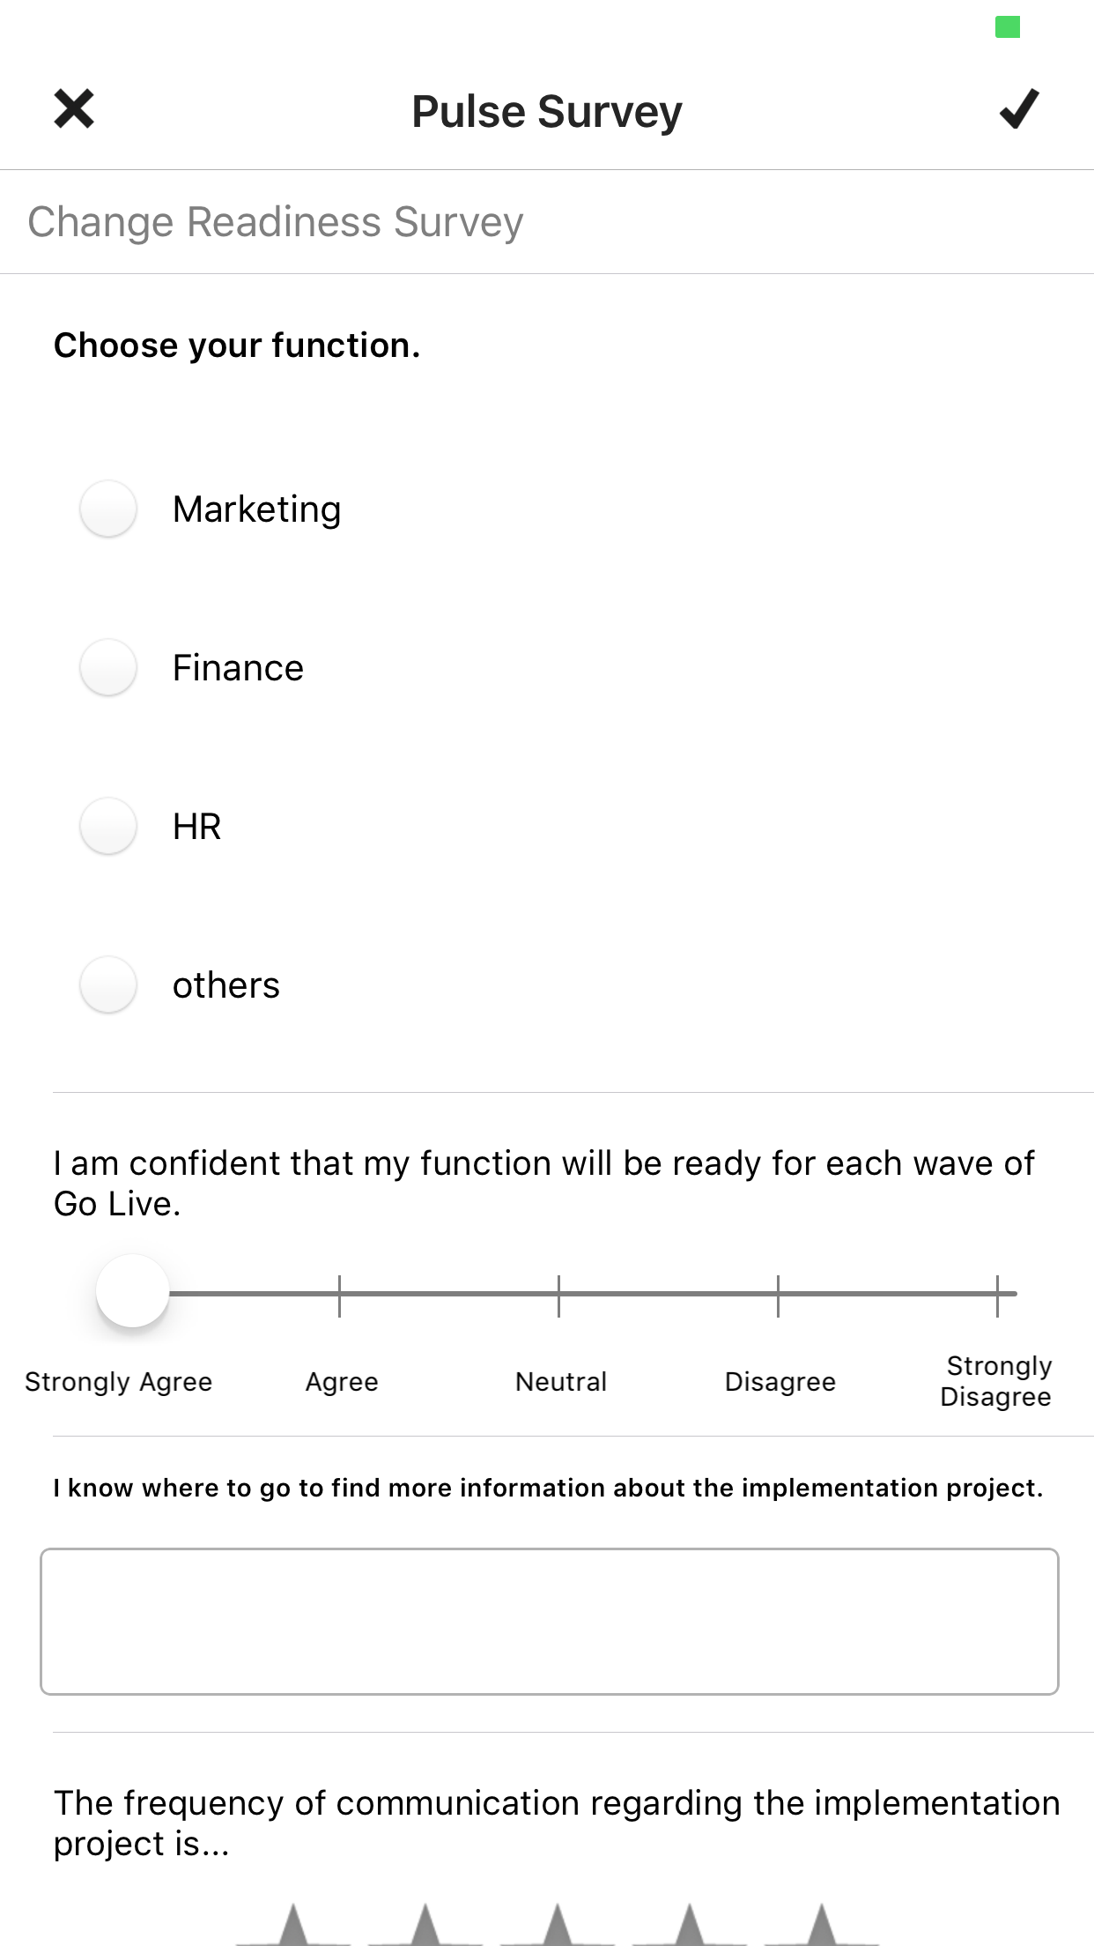


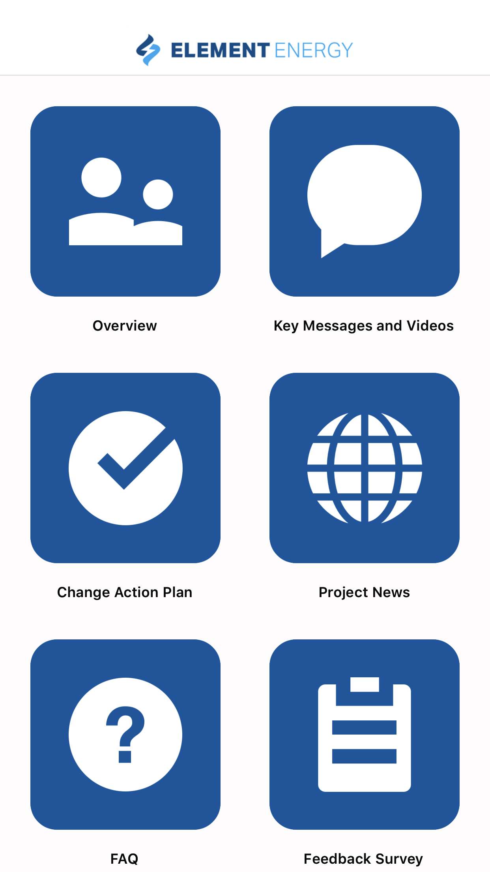
PwC’s Change Communicator aims to simplify program communications
A custom mobile app that allows teams to deliver change communications direct to employees phones
Custom mobile UX
Track user engagement
Engaging design templates enable customization of the look and feel of the app, while core features like role-based content, push notifications, and YouTube integration deliver a compelling user experience.
Pulse surveys allow “voice of the employee” feedback to inform future strategy decisions, while usage analytics track who’s using the app, how frequently, how long, what sections are they visiting, and overall app traffic.
How do I manage the app?
Why is Communicator effective?
Communicator’s simple web-based CMS, powered by AppBurst™, enables project teams to easily manage app content. Create new pages, upload new images and PDFs, link to relevant YouTube videos, tweak designs, and analyze user analytics directly from the control panel.
It addresses the common issue of low employee engagement with change communications by giving them convenient access to all relevant content directly from their mobile device, in addition to traditional channels like email and intranet/Sharepoint sites

Slide 21
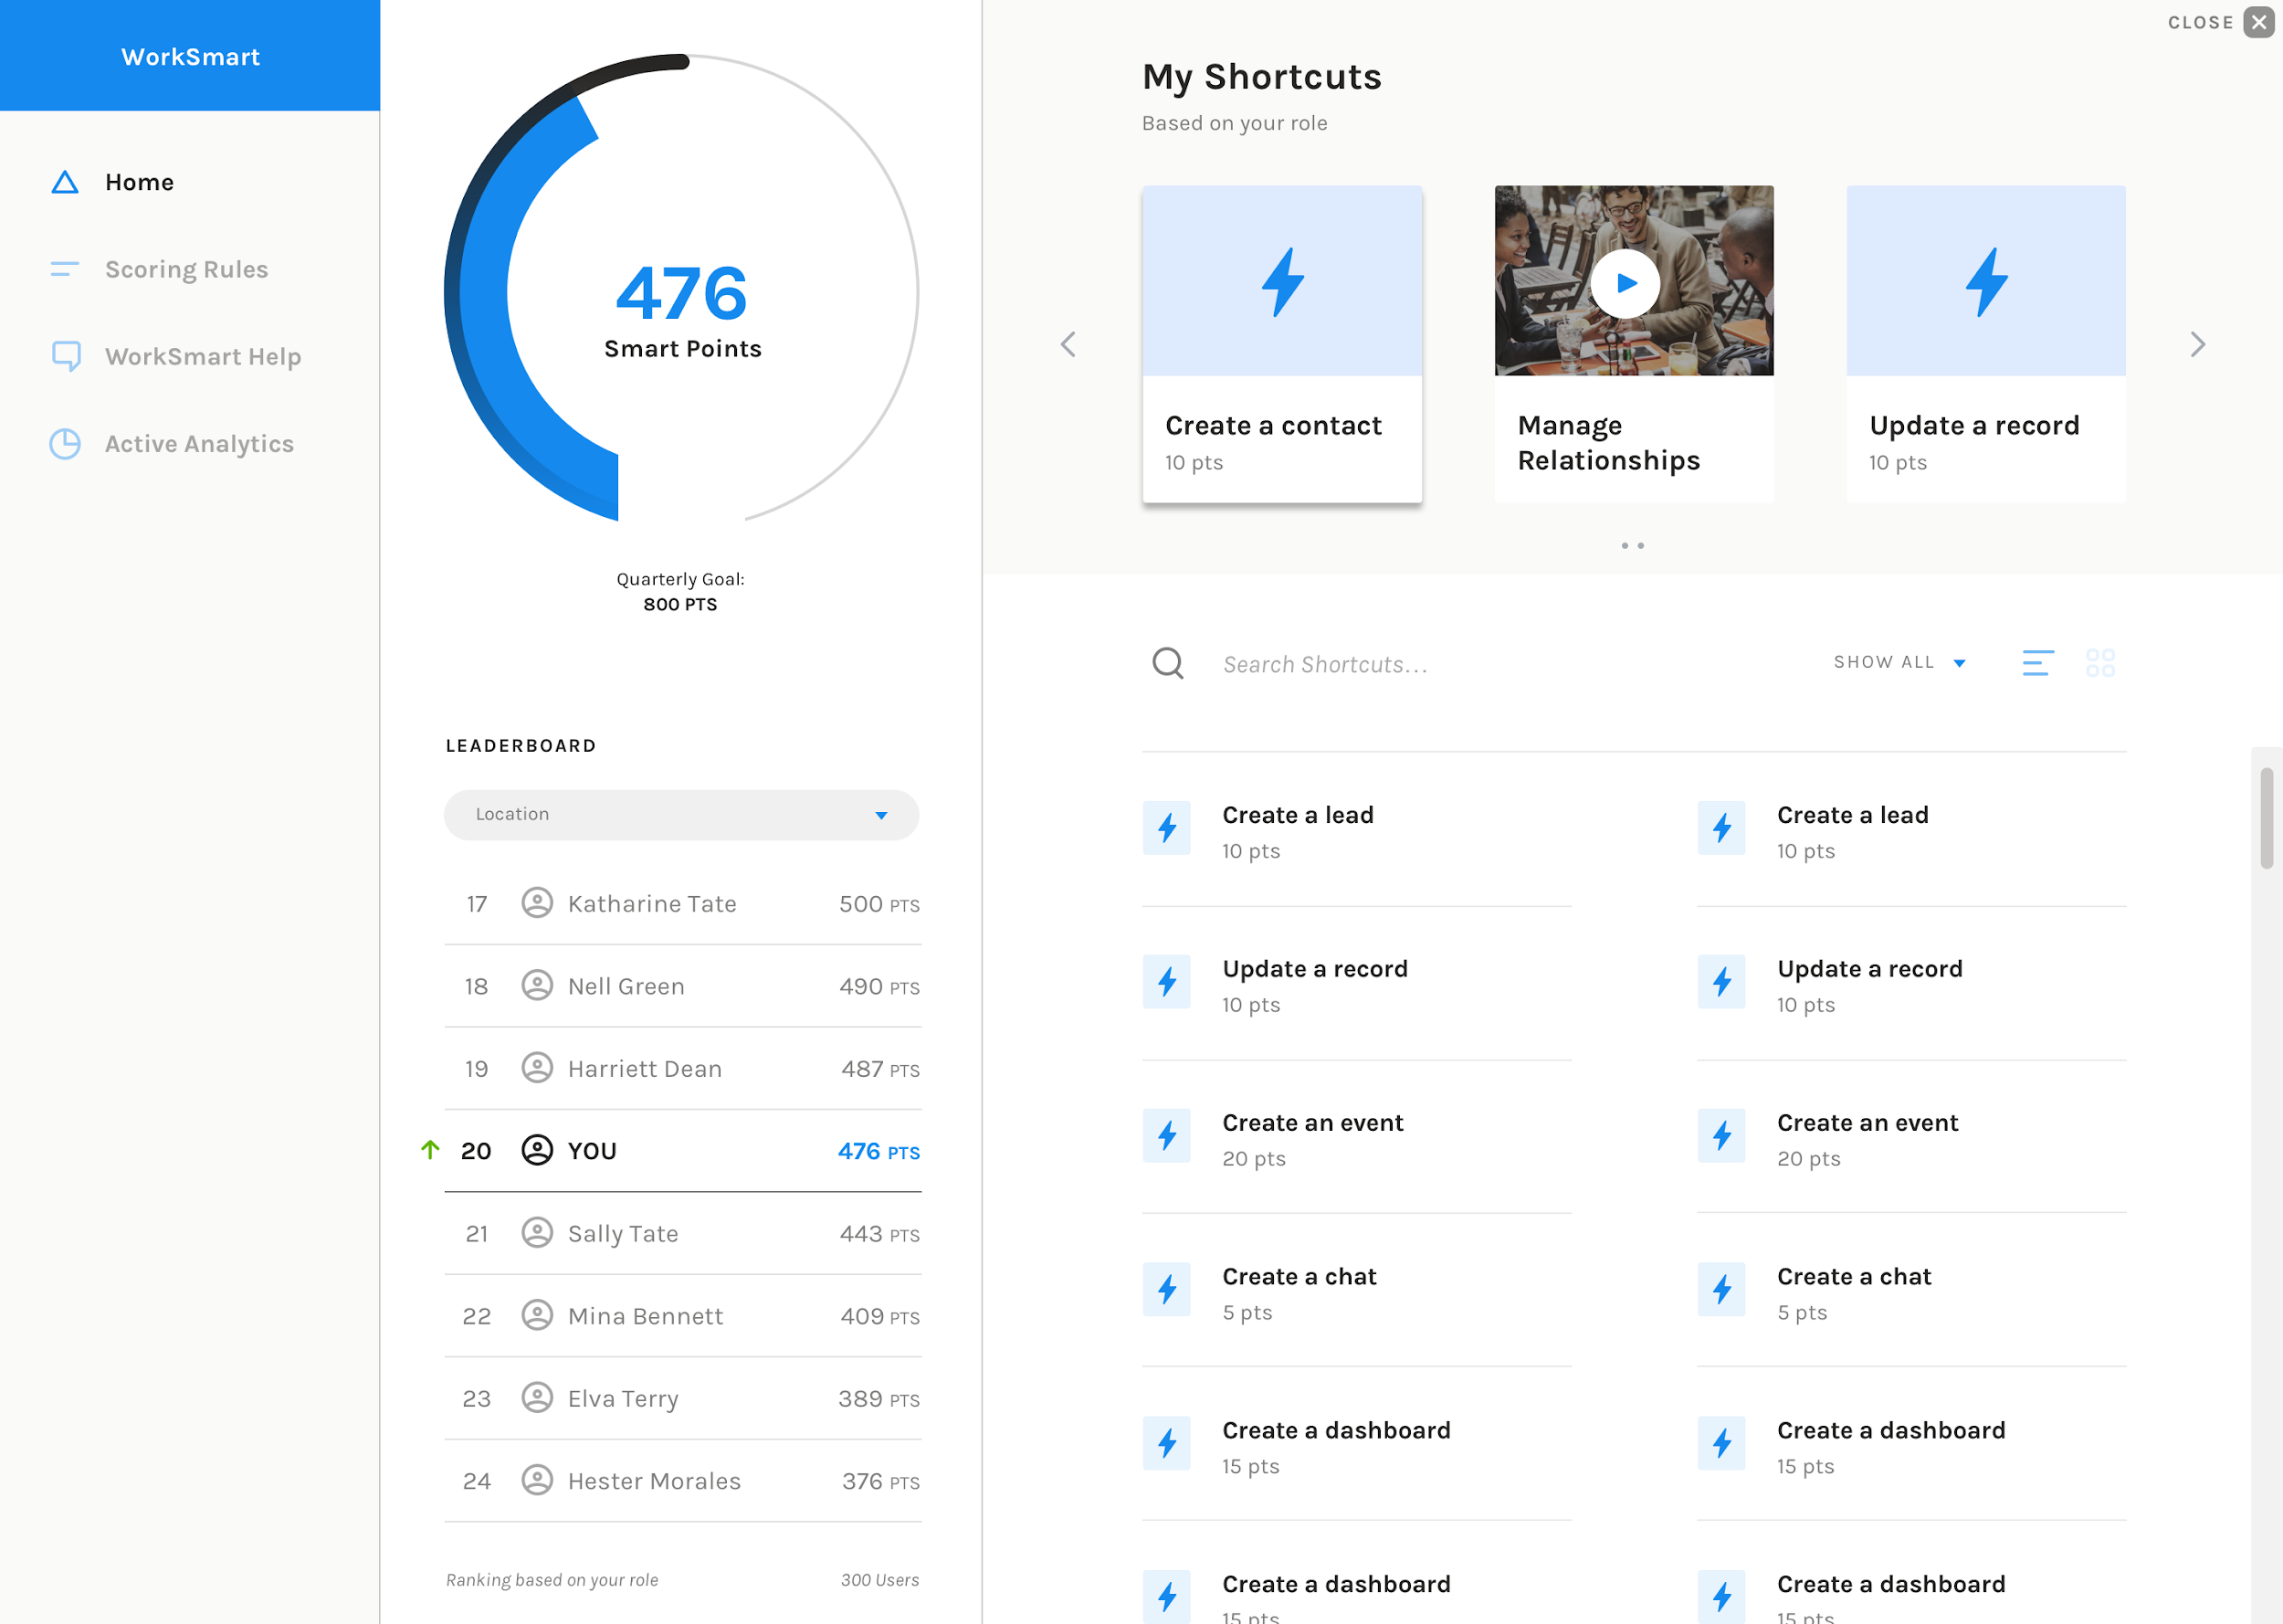
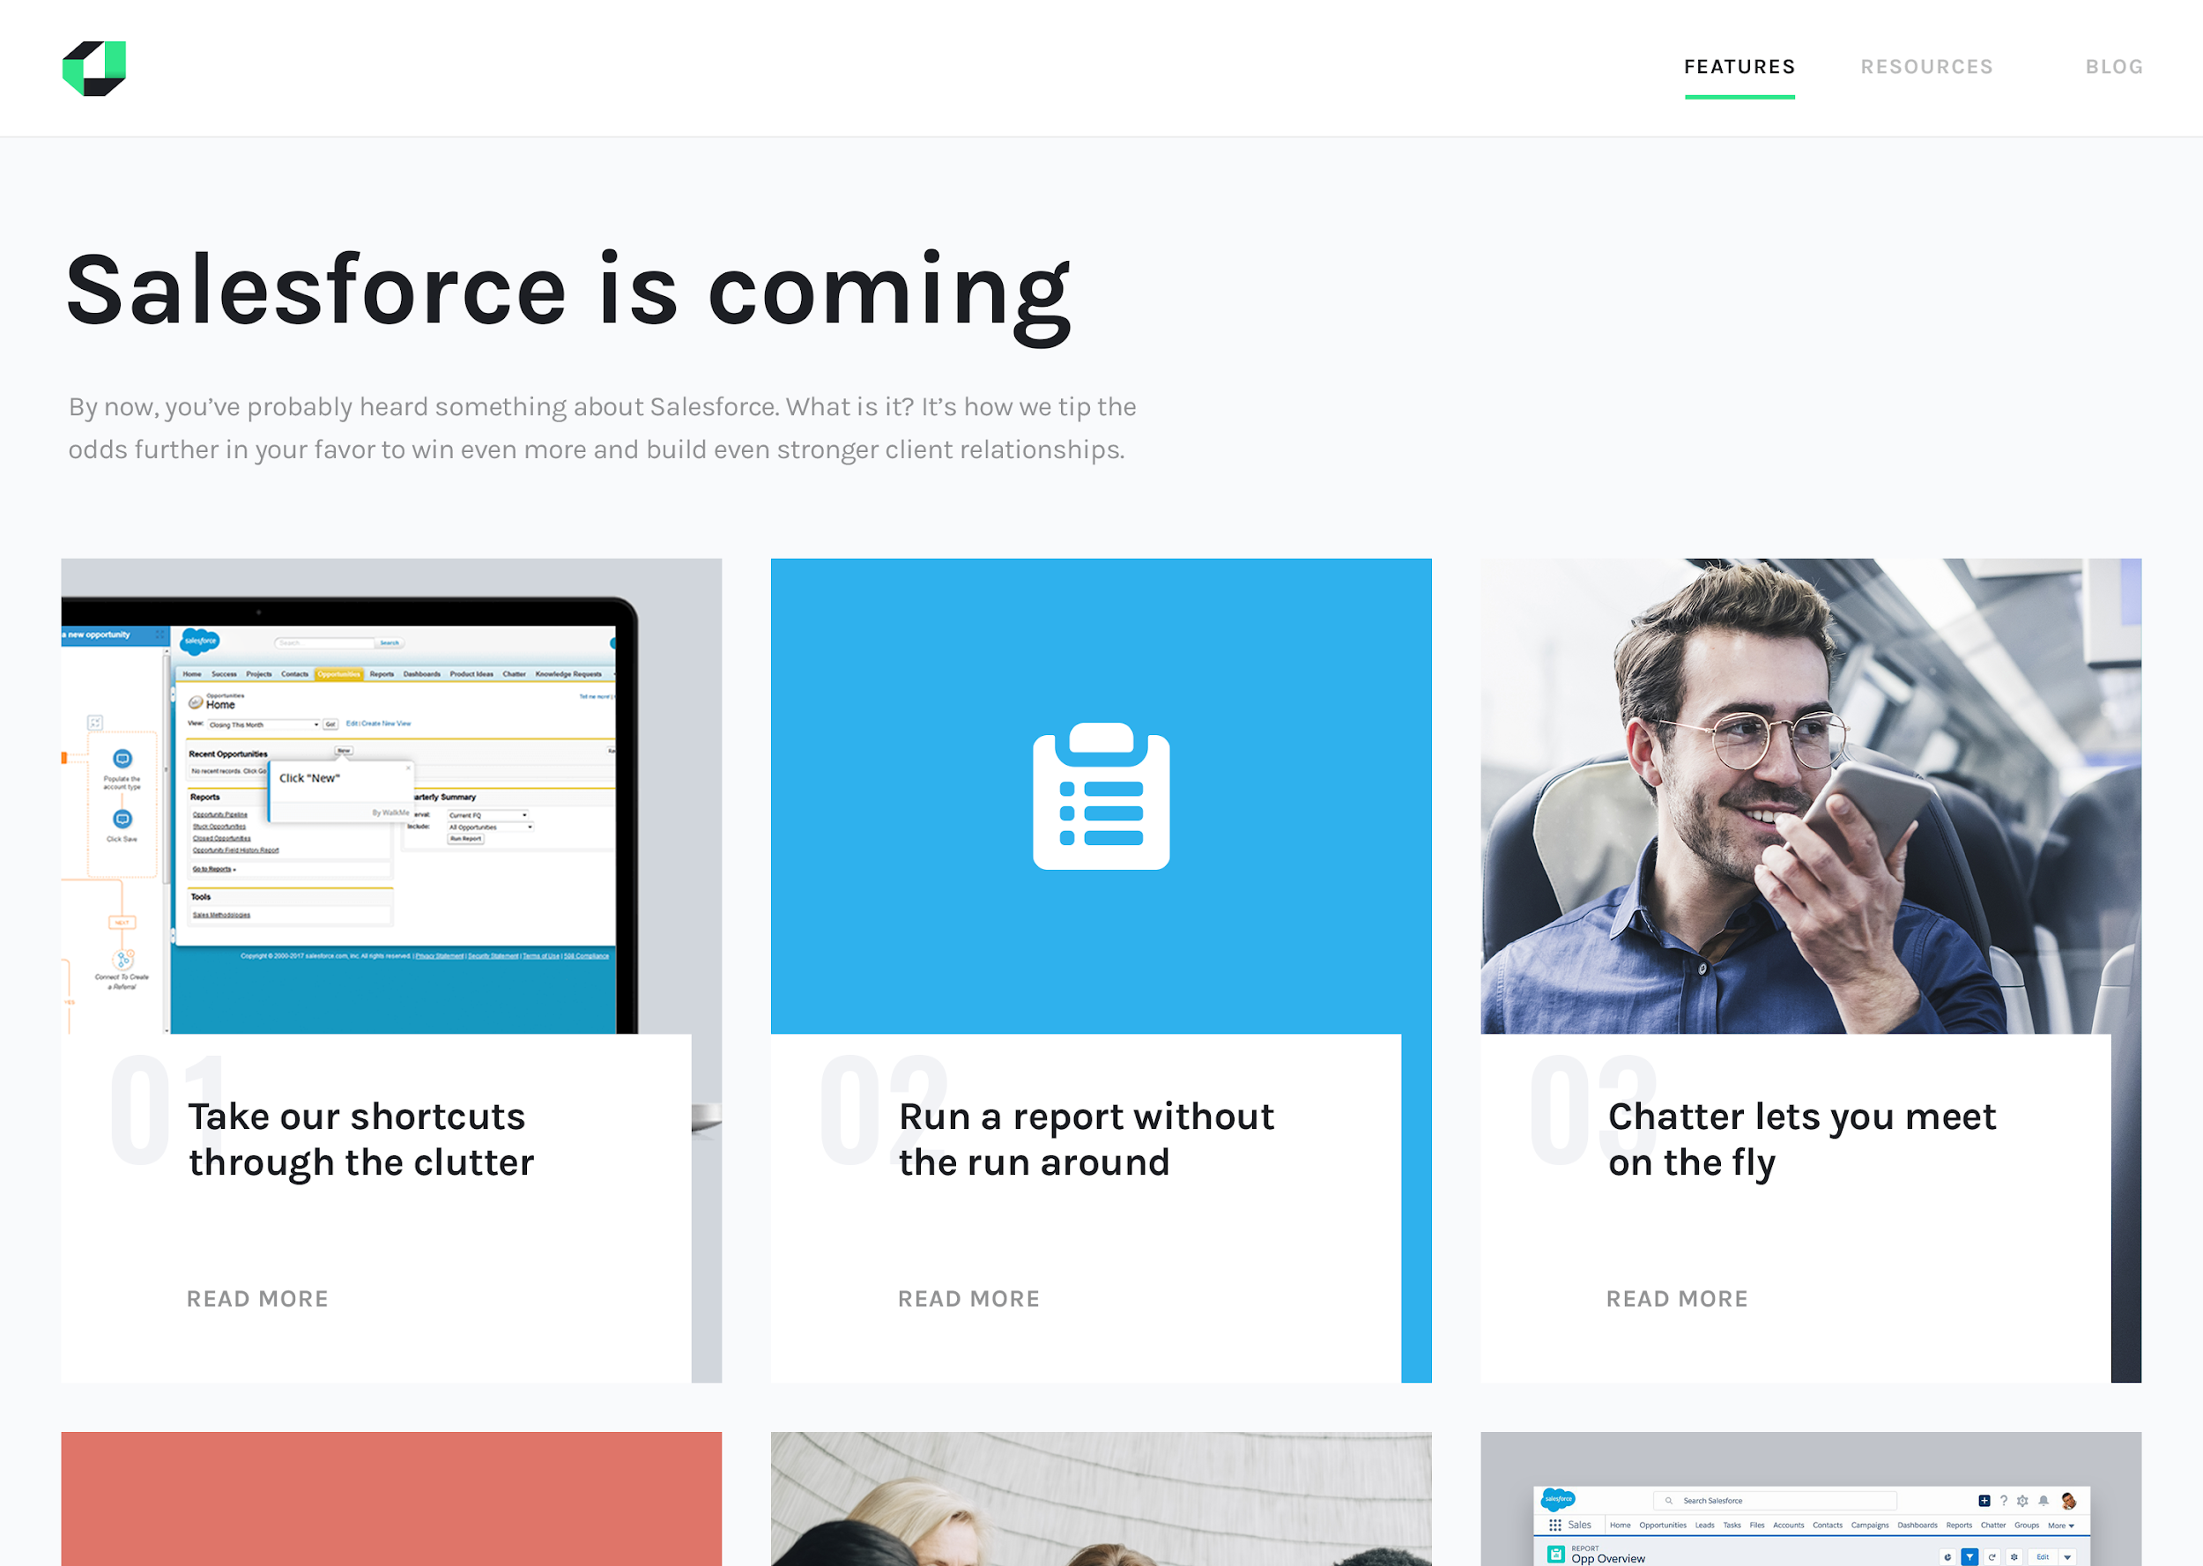
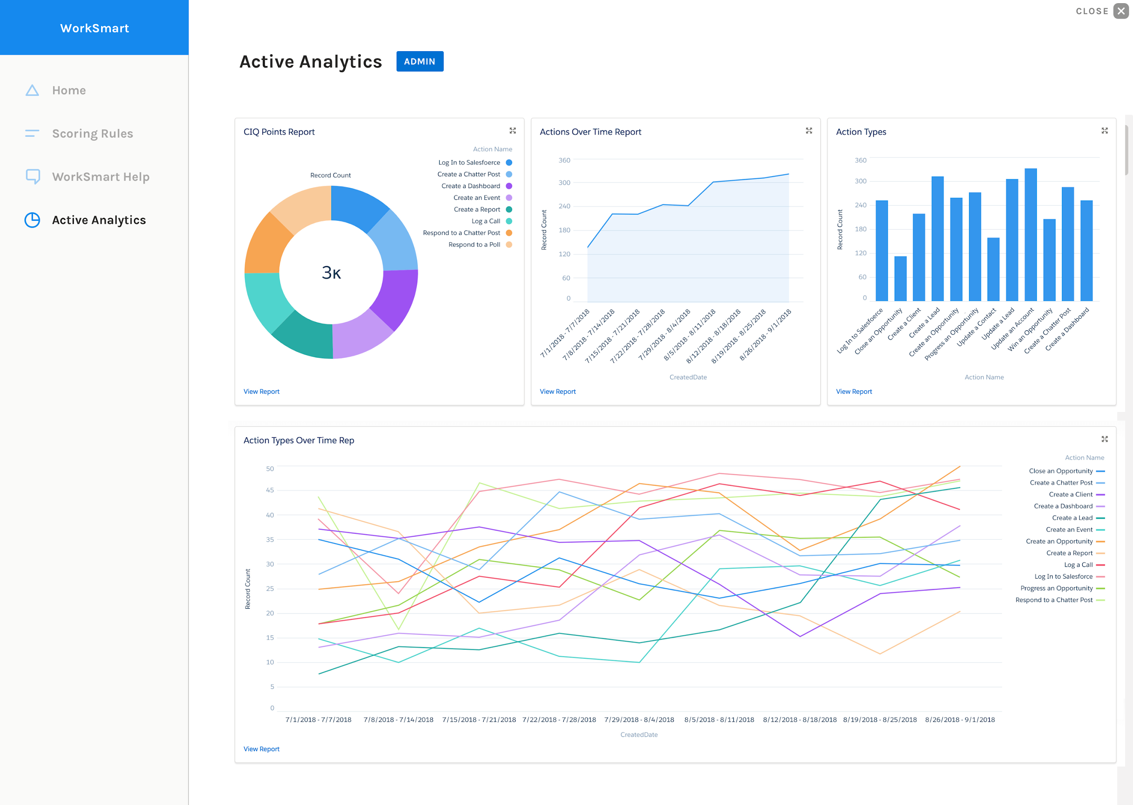
PwC’s AdoptIQ: intelligent adoption for enterprise digital
Adopt IQ is a continuous adoption platform that gives you one consistent, engaging way to learn across all of the enterprise systems in your organization, now and in the future. That means you don’t have to reinvent the wheel every time you introduce something new into your ecosystem. It means you spend less time and money getting your people up to speed on new tools and more time seeing results.
AdoptIQ Features:
Campaign Communications: Building excitement and awareness.
Campaign Sites: Removing resistance to change.
WorkSmart: Incentivizing the right behaviors.
Shortcuts: Training that doesn’t feel like it.
Active Analytics: Making adoption analytics actionable.

Slide 22
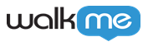
WalkMe is an in-app tool that can enable a seamless training journey
WalkMe is a digital adoption platform that delivers embedded content to users on-demand as they navigate through the technology platforms they use. It is a cloud-based, in-app tool that fosters an optimal user journey, reducing the need for support and ensuring user adoption through intelligent guidance.
Benefits of the tool:
Guidance: Drive users to action and ensure true adoption with a layer of visual clues and strategically placed content.
Engagement: Identify opportunities for engagement by understanding who, how, when and where to engage.
Insights: Collect and utilize usage data to recognize behavior patterns and obstacles.
Automation: Enjoy a better UX and higher productivity by eliminating empty clicks and tedious tasks.

Slide 23
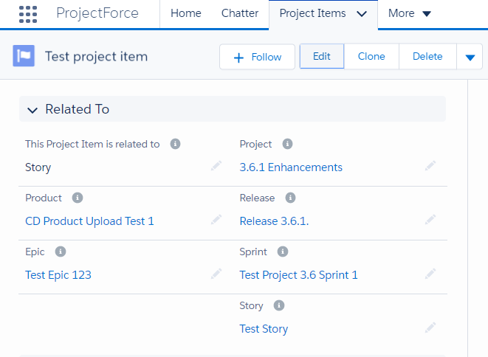
PwC’s Project Force: collaborative project management
Project Force is a PwC-built, native Salesforce tool for collaborative project management.
Helps teams stay on track
PROVIDE FLEXIBLE SOLUTION DEVELOPMENT
MANAGE A BACKLOG OF USER STORIES
The product help teams stay aligned on goals and track task requests from concept through delivery with transparency, collaboration and real-time insights.
ENGAGE & INFORM STAKEHOLDERS
LAUNCH PROJECTS & PLAN STORY DELIVERY
Enables a “One Team” approach
GAIN FULL VISIBILITY & TRACEABILITY
STREAMLINE ASSIGNMENTS & TRACK BUILD EXECUTION
Stakeholders have insight on real-time status and next steps around key project activities. Project teams run real-time reporting, proactively manage project risks and use collaboration features to keep client stakeholders and team aligned.
RECEIVE DAILY STATUS UPDATES & REPORTS
ASSURE QUALITY & MANAGE RISKS
COMMUNICATE EFFECTIVELY & HEIGHTEN COLLABORATION

Slide 24

5 – Sample Engagement Models
24

Slide 25

Our change approach can be tailored to client needs...
Change management programs are not “one size fits all” — different organizations have different change needs. PwC will right-size our recommendations and level of involvement to fit the specific nature of this implementation, the already-defined culture at client, and the particular needs of the your organization.
Low Effort
Medium Effort
High Effort
Review, Asses, Design
Assess, Design, Deploy
Assess, Design, Deploy, Operate, Stabilize
PwC identifies change impacts
PwC develops change strategy, plans, and implementation toolkits
PwC facilitates knowledge transfer, trains client internal change team to implement the change management approach, and equips them to use the toolkits and accelerators
Training: PwC develops high-level Training Plan with execution by internal client staff
Low Effort option PLUS:
PwC provides part-time change management advisory and coaching support throughout project life cycle
Client implements all change activities with support from PwC
Training: PwC develops Training Plan, Job Aids/Process User Guides, Training Material as appropriate; TTT, client delivers
Medium Effort option PLUS:
PwC identifies and defines job roles for the transformed organization
PwC develops and executes all change and comms materials
PwC onboards, educates, and manages change agent network(s)
Training: PwC develops Training Plan, Job Aids/Process User Guides, Conducts Master Trainer Sessions, delivers, etc.

Slide 26
...with staffing models that flex accordingly
Low Effort
Medium Effort
High Effort
Review, Asses, Design
Assess, Design, Deploy
Assess, Design, Deploy, Operate, Stabilize
Timeline
3 - 4 months
4 - 6 months
6 - 8 months
Partner: 2%
Director: 10%
Manager: 50%
Senior: 100%
SDC or TalentExchange or SDC: 40 hours total
Partner: 3%
Director: 30%
Manager: 100%
Senior: 100%
TalentExchange or SDC : 60 hours total
Partner: 3%
Director: 50%
Manager: 100%
Senior: 100%
TalentExchange or SDC: 120 hours total
Staffing
Model

